Slide 1
Java SE 17 – Presentation
Chapter 12 – Modules

Slide 2
Chapter 12 – Module
Introducing Modules
- When we studying for the exam, we will only see small ... However, in real life, these ... will have ... large ...
– In an enterprise system, it will have ... even ... packed in ...
– These ... will also be packed inside ... file along with some ... files
- Moreover, ... program including the one that ... also contain ... software (OSS is ...) (for example, JDBC)
- Some of the OSS ... also depends on ... (for example, Spring or JUnit). To use these, we need to make sure ... enough or minimum ...
- Devs has a term to call these cyclic ... called ... to refers to incidents ...
– JPMS (or ...) group codes at ... with the primary ... is to ... packages with different ... into a .... It looks like a ... file, but with an additional feature is to allow devs to ... access ...
Exploring a module
- In chapter 1, we have developed a program ... zoo. But it was ... version, and now we want to ... all processes => There will be many ... needed to ... (animal, visitor, ...)
- A module is a ... + a special file called ... This file is used to ... declaration

Slide 3
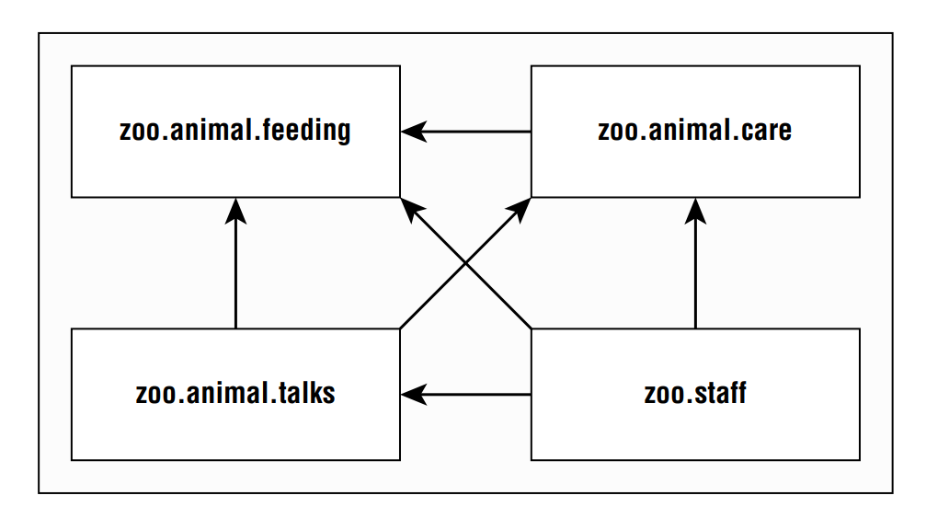
Chapter 12 – Module

Slide 4
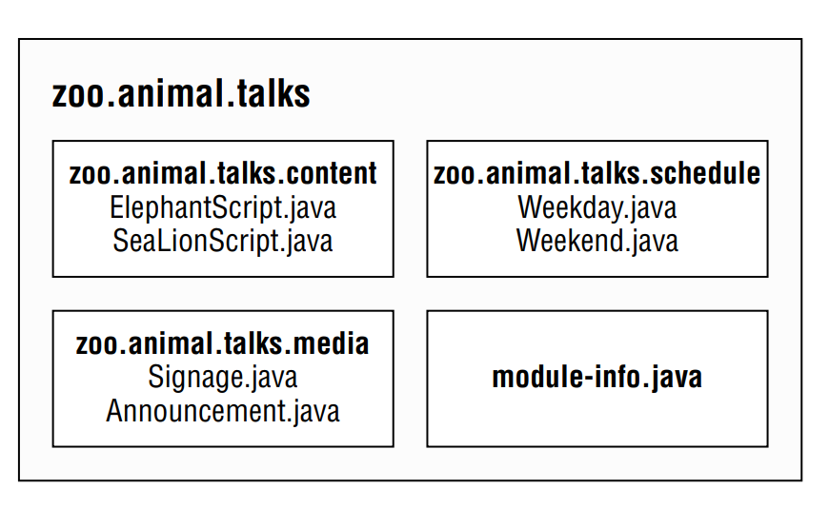
Chapter 12 – Module

Slide 5
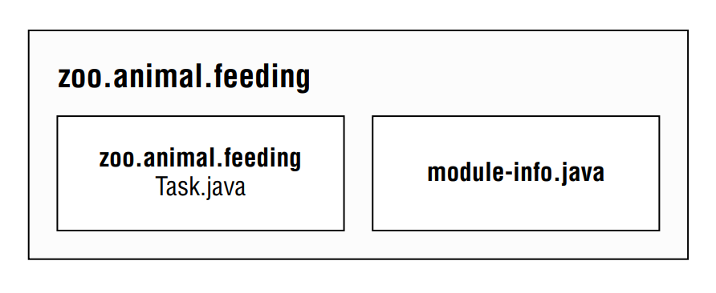
Chapter 12 – Module
- Some of the benefit of using ...
+) Better ... control
+) Clearer ... management
+) Custom ...
+) ... security
+) Performance ...
+) Unique ... enforcement ...
Creating and Running a modular program
-) The master diagram shown that most ... depends on ... => We will create ... first ..

Slide 6
Chapter 12 – Module
Creating the Files
- First we will ... simple ...
(code illustration snippet 1)
- There are few things we ...
+) The ... file must be in ... directory ...
+) The ... declaration must start with ... not ...
+) The module name must follow ... Package and class name aren't allowed to have ... => ... is the same ...

Slide 7
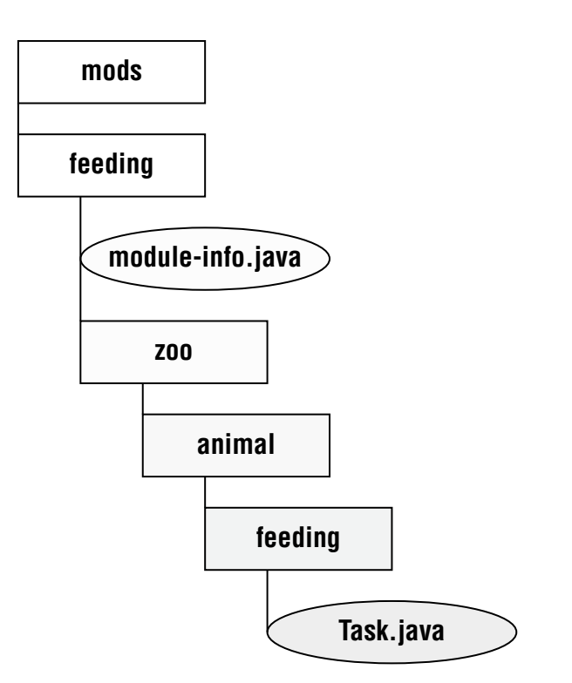
Chapter 12 – Module

Slide 8
Chapter 12 – Module
- We can see that ... folder called ...
– This folder is used to ... module ... (later on in the chapter)
- The name .... but it is ...
Compiling our first Module
- Before we run, we must ...
(code illustration snippet 2)
- The new part in the command is the ... , it will specify ... other ... depends ... (in this example, we ... yet so we can ...)
- Just like classpath, we can ... it by using ...

Slide 9
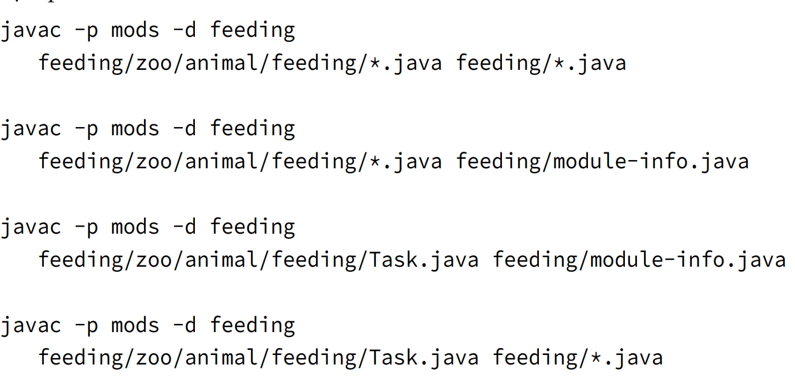
Chapter 12 – Module

Slide 10
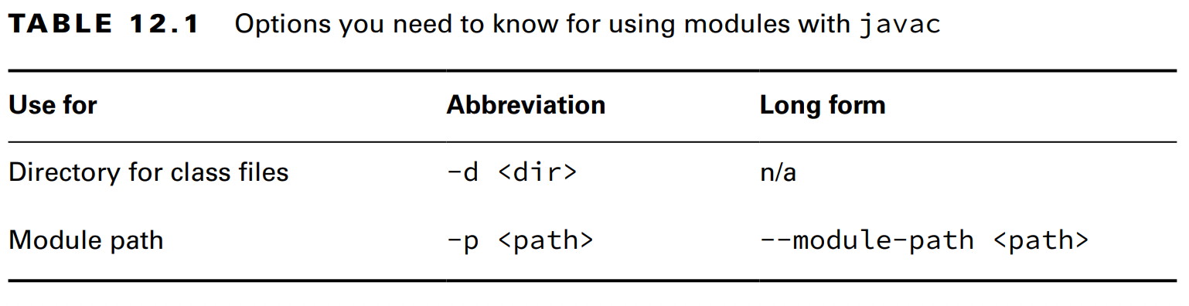
Chapter 12 – Module

Slide 11
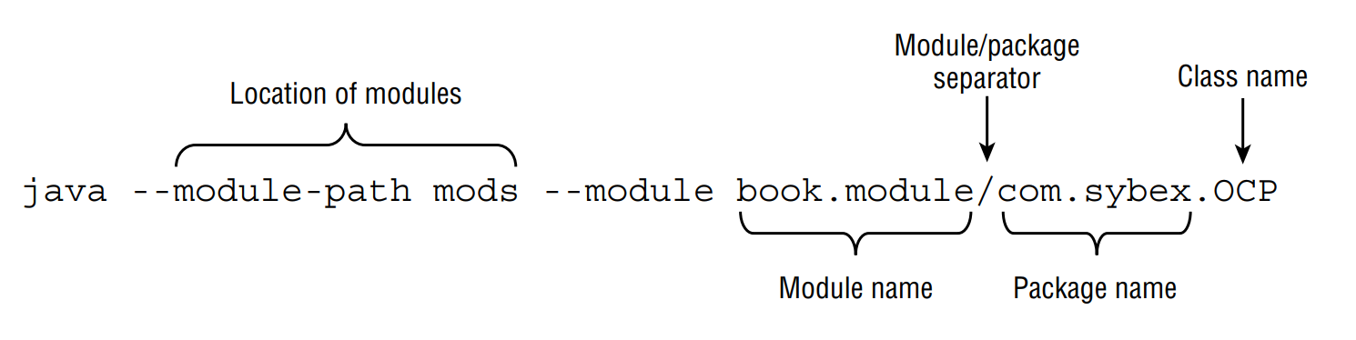
Chapter 12 – Module
Building Modules
- Even if we don't use ..., the ... complexity will ... as the project ... if we use ... manually
- People prefer to use ... tools such as .../...
– These tools will recommend where ... (usually .../...)
Running our first Module
- Before we ... our module, we ... test it to see ... We have to know the ... to run ...
- For example, we have ... book.sybex and ... com.sybex.OCP ...

Slide 12
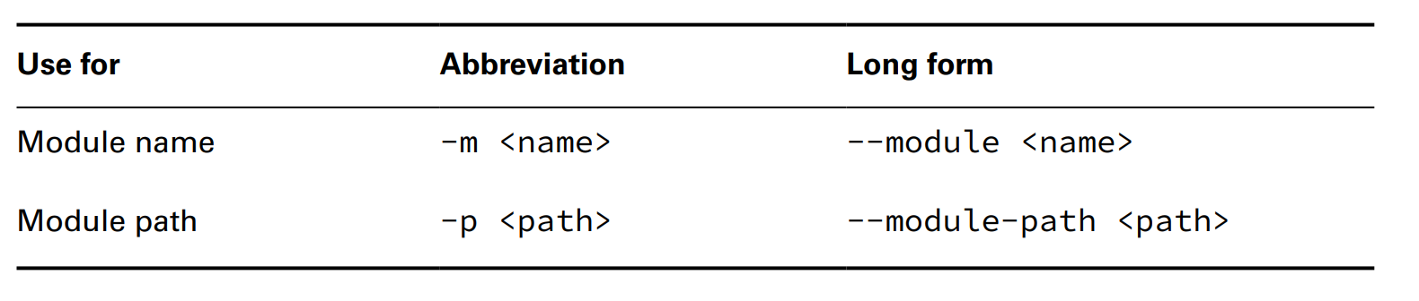
Chapter 12 – Module
(code illustration snippet 3,4)

Slide 13
Chapter 12 – Module
Packaging our first Module
- Module won't ... if we just use it to ... in ... We must pack it to ... (note: the directory for ... must be ... first)
(code illustration snippet 5,6)
Updating our example for multiple modules
- The first module is completed, now we ... We can see that the feeding module depends by ...
Updating the Feeding Module
- The ... directive is used to tell Java that this module is used by other ...
- If we don't have this directive, then ... and we can only ... in terminal
- Because we want other ... to use ... we must specify it in ...
(code illustration snippet 7)
- Recompile and ... will ...
(code illustration snippet 8)
Creating a Care Module
- Next, we will create the zoo.animal.care ... This ... will contain 2 ... The first one is ....medical, it will be ... and the second one is ....details, which won't be ... (just like how medical record ...)

Slide 14
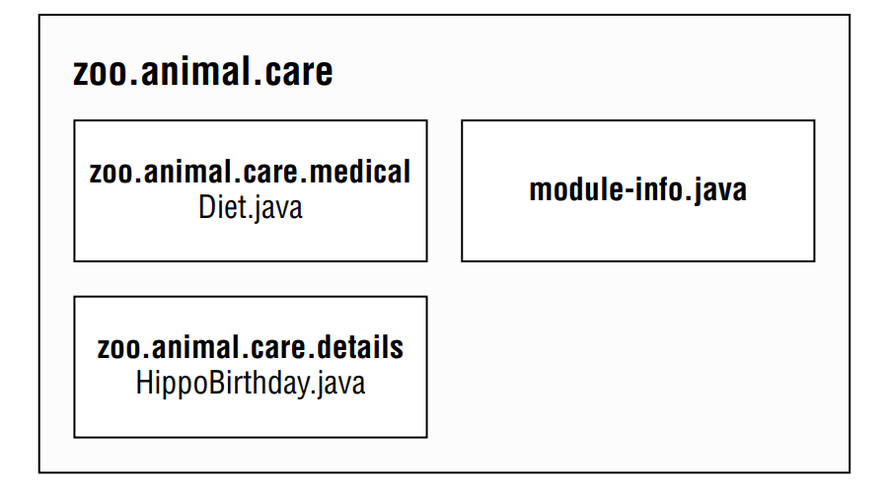
Chapter 12 – Module

Slide 15
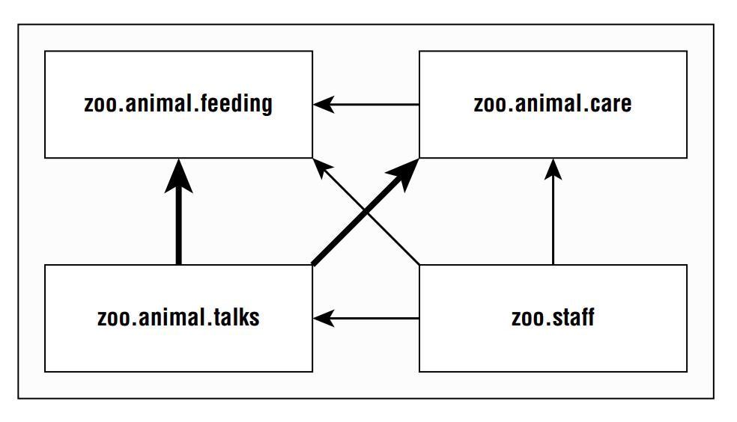
Chapter 12 – Module
(code illustration snippet 9)
- There are 1 new ... which is ... used to specify that this ... requires ...
(code illustration snippet 10)
Creating the Talks Modules
- Up until now, we just handle single ... and ...
- Now we will ... and ... multiple ... at the same ...
- In the following picture, we can see that the Talk ... depends on ... simultaneously ...

Slide 16
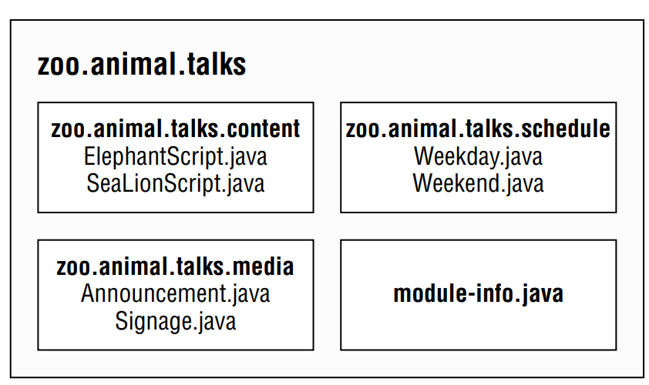
Chapter 12 – Module

Slide 17
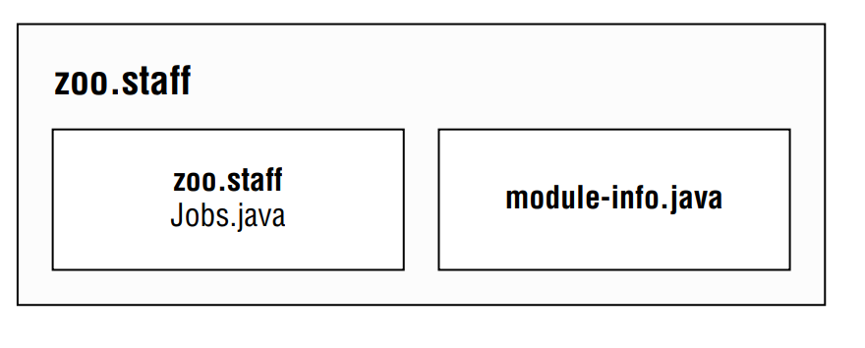
Chapter 12 – Module
(code illustration snippet 11)
Creating the Staff Module
- With this module, no ...

Slide 18
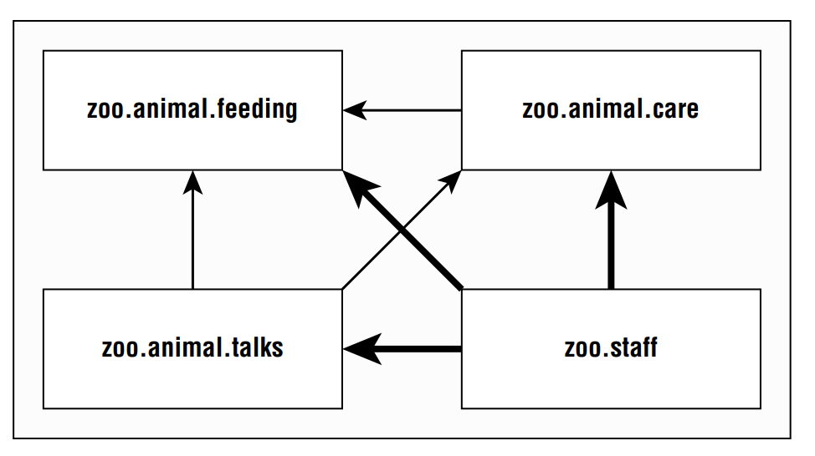
Chapter 12 – Module

Slide 19
Chapter 12 – Module
- Because there will be no ... => ...
(code illustration snippet 12)
Diving into the Module Declaration
- In this section, we will talk about 3 ... ...,..., and ...
– In the next part, we will talk about ... and ... directives
– Please be advised that these ... could ... order ...
Exporting a package
- We have seen that we can allow ... from other ... by using ... Now we can export single ... for other ...
(code illustration snippet 13)
- Only ... need the ... module then why do we need to ... ? Because we can't predict ... so we need future-proof
- Any package need other ... => only ...
Exported type
- What does "export" actually mean ? All public ..., ..., ... are all ... Moreover, all .../... method and fields in these ... are ... from ...
- Only .../... field and method aren't ... because ...

Slide 20
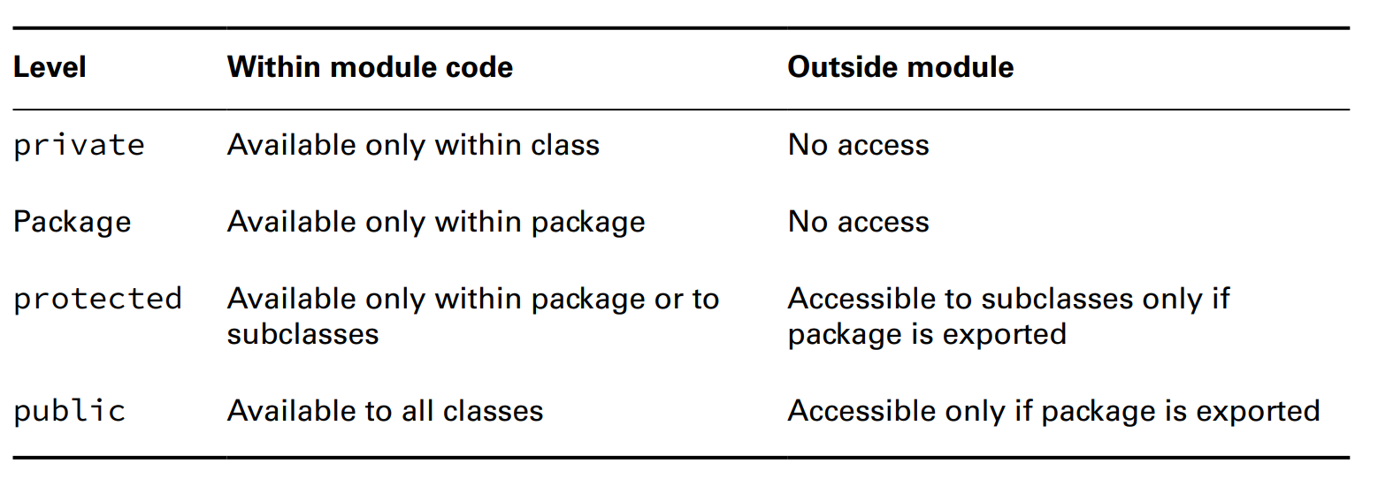
Chapter 12 – Module

Slide 21
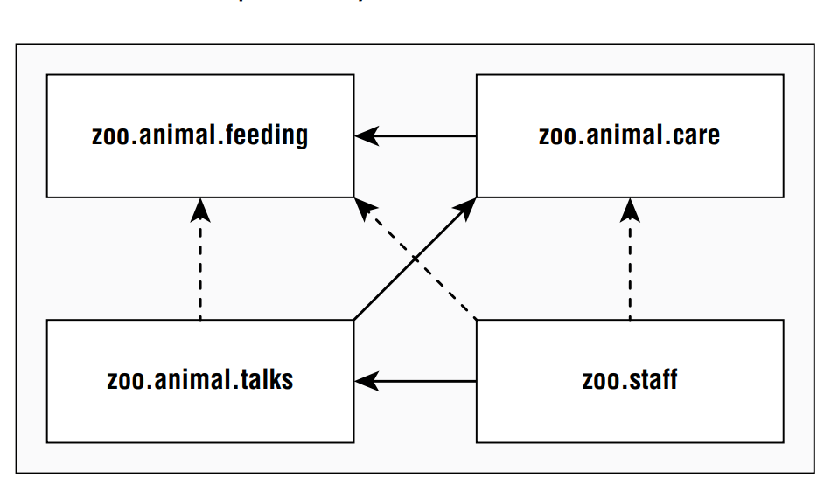
Chapter 12 – Module
Requiring a Module Transitively
- requires ... in the last ... means ...
- We also have a new ... called "requires ..." which means ... also ...

Slide 22
Chapter 12 – Module
- With transitive, the ... arrow means ... while the ... arrow means ...
(code illustration snippet 14)
- Because all ... also depend on ... module and ... module => We just need to specify ... in ... module
(code illustration snippet 15)
Effect of requires transitive
- Here are some effects of the ...
+) The talks module can declare ... optional ...
+) ... modules won't compile if ... access is not ...
- These rules will still ... even if ... modules don't ... any ... in ... module
Duplicate requires Statements
- The exam can trick us with ... statements => This is ... allowed ...
Opening a Package
- Java allows ... to "inspect" and "call" ... with a technique called .... This is a powerful technique that allows ... code that is ... available at ... time. This technique can even be used to hack ... (question 1). However, we don't need to know about .... The directive ... is used to use the .. feature ... module... We just need to know its ... without how it ..
- Because this is a dangerous ..., Java requires us to ... it inside ... file
(code illustration snippet 16)

Slide 23
Chapter 12 – Module
Opening an Entire Module
- In the previous ... we have ... Now we want to open the entire ... => We just need to add ... before ...
(code illustration snippet 17)
- Once we use ..., it is guranteed that ... => Mix with ... dead ...
(code illustration snippet 18)
Creating A Service
- In this section, we will create a ...
- A service is comprised of ..., ..., ... (Note: ... class ... is not ..., it is ...)

Slide 24
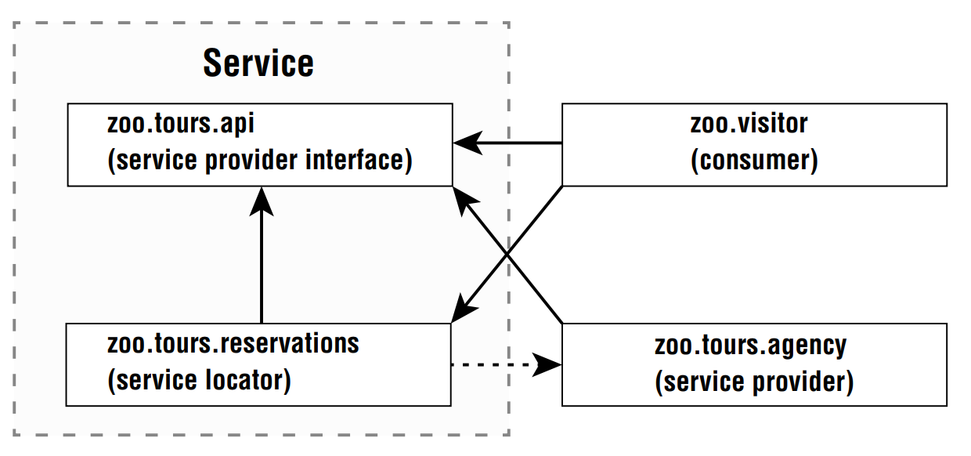
Chapter 12 – Module

Slide 25
Chapter 12 – Module
- Note: we don't need to ... like the picture, the book does that for ... In fact, we just can ... in a single ...
Declaring the Service Provider Interface
- In zoo.tours.api, there will be ... object ... Sourvenir. This is a part of ... because it .... interface ...
(code illustration snippet 19)
- This module will ... interface, this is called ... interface ... because ... defines ... of the service
(code illustration snippet 20)
- We will allow ... from outside of ...
(code illustration snippet 21)
- Now we will run and jar the code
(code illustration snippet 22)
- A ... could be a ... class not just interface (but exam always ... so we just ...)
Creating a Service Locator
- To complete our ..., we need something called ... The ... will find any ... that ... the interface ... Java will return any ... (this also called implementation ...)
(code illustration snippet 23)
- Note: the call for ... consumes ... so it is recommended to ...

Slide 26
Chapter 12 – Module
- The ... file will ... the module, and because we need ... locate ... we need to requires .... The ... directive is used to specify that we need to find ...
(code illustration snippet 24)
- Now we will compile and jar the module
(code illustration snippet 25)
Using ServiceLoader
- There are ... methods in ... class we need to know
load()
stream()
- The ... method returns different ...because ... controls the element when evalutating => The returned ... will be a ... provider .... We will need to use get() to ... corresponding to ...

Slide 27
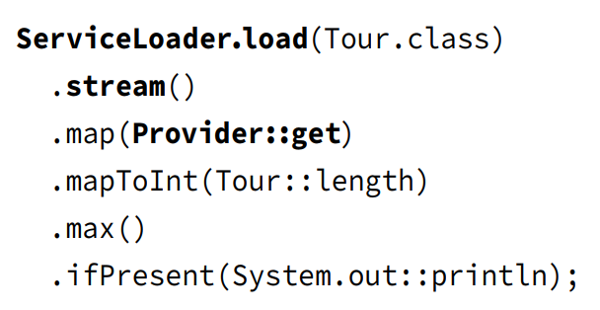
Chapter 12 – Module

Slide 28
Chapter 12 – Module
Invoking from a Consumer
- Next, we will call ... from a ... (...)
- Consumer(...) refers to the module that ... and ... the service. Once the ... get the ... through a ... locate ... It will use methods inside ...
(code illustration snippet 26)
- The current ... declaration doesn't need to know about ... because the ... locate ... handling the ....
(code illustration snippet 27)
- Now we will compile and jar the program ...
(code illustration snippet 28)
Adding a Service Provider
- A Service Provider is ... of the ... interface ... At runtime, we could have many ... of the ... interface ... But here we will just ... for simplicity ...
(code illustration snippet 29, 30)
- The directive ... is used to specify that ... is a ... of the ... interface ...
– We have to use ... because we don't want ... directly on the ... This allows us to provide specific ... for a ...
– Note: We don't export ... containing the ... instead, we will make the ... available with the ... interface
(code illustration snippet 31)

Slide 29
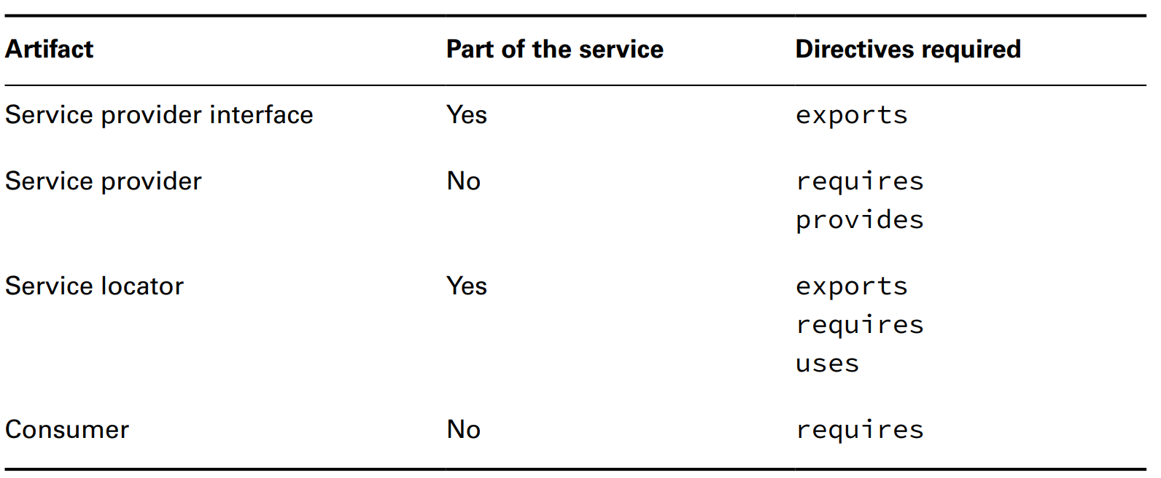
Chapter 12 – Module
- Notice that we don't need to recompile ... and ... because we already got ... to find ...
– This feature is useful when you have ... that ... regularly and ... from the codebase
- In software development, the definition for separating ... into ... is called Loose Coupling. The advantage of ... this is we can ... deep with minimal on ... other ...
- Depending on Loose Couple will allow the app to ... easily at ...
Reviewing Directives and Services

Slide 30
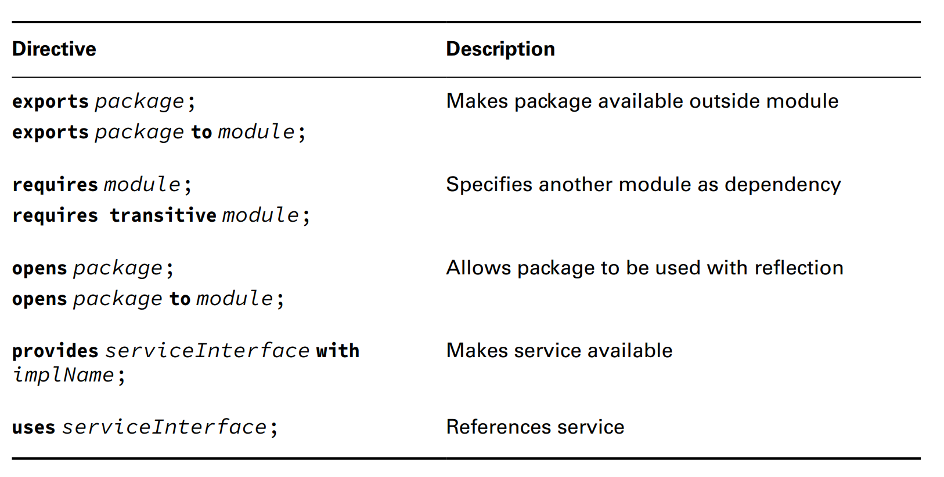
Chapter 12 – Module

Slide 31
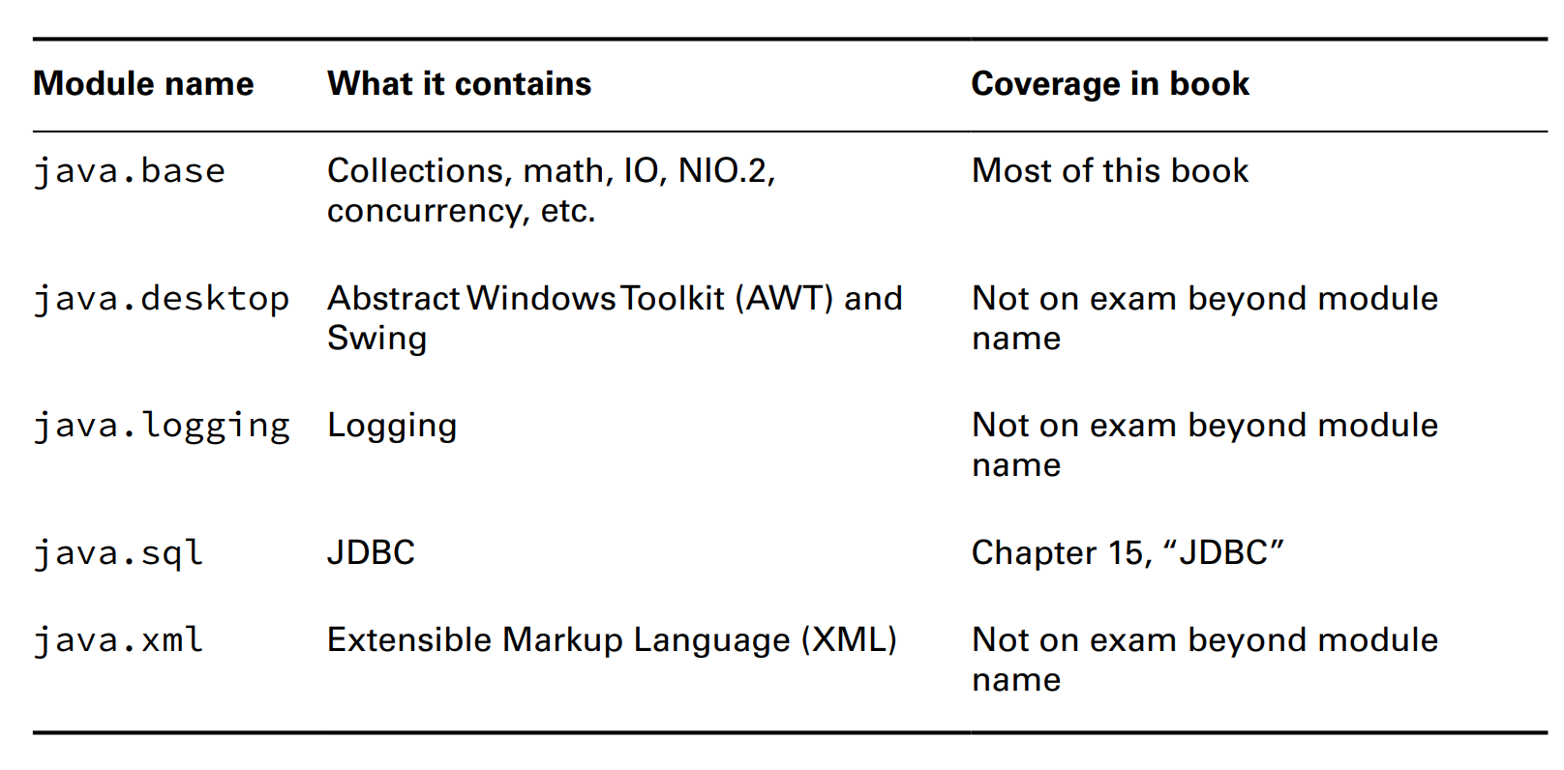
Chapter 12 – Module
Discovering Modules
- Up until now, we are just working with ... All classes in JDK are also ...
(Note: we won't need to know the output of the command, we just need to know what it is, syntax ...)
- The most important module we need to rememeber is ... It contains most of our ... in exam. Its importance is so large that it is the same as ... (automatically ...)

Slide 32
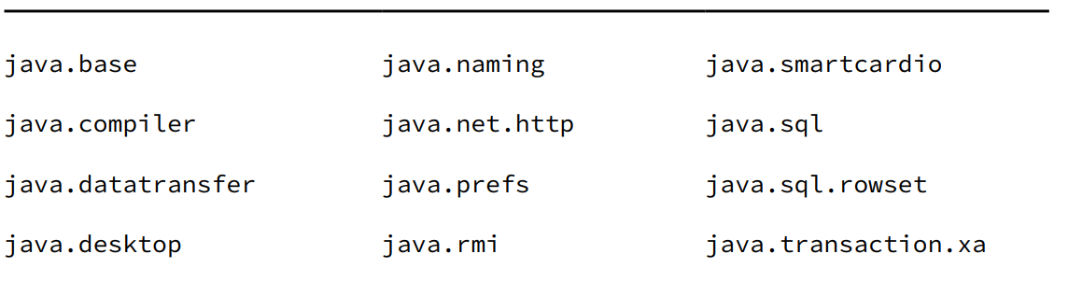
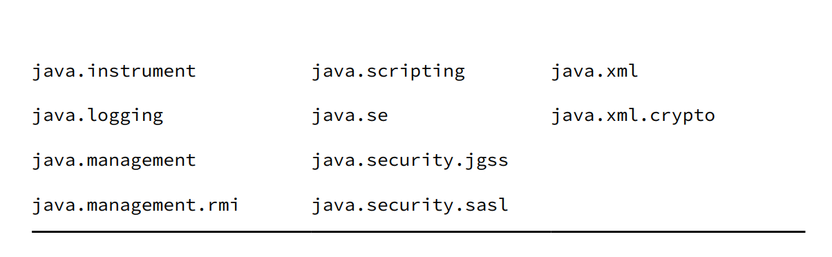
Chapter 12 – Module
- For the exam, we must remember that the ... related to ... will start with ... and the ... related to ... will start with ...

Slide 33
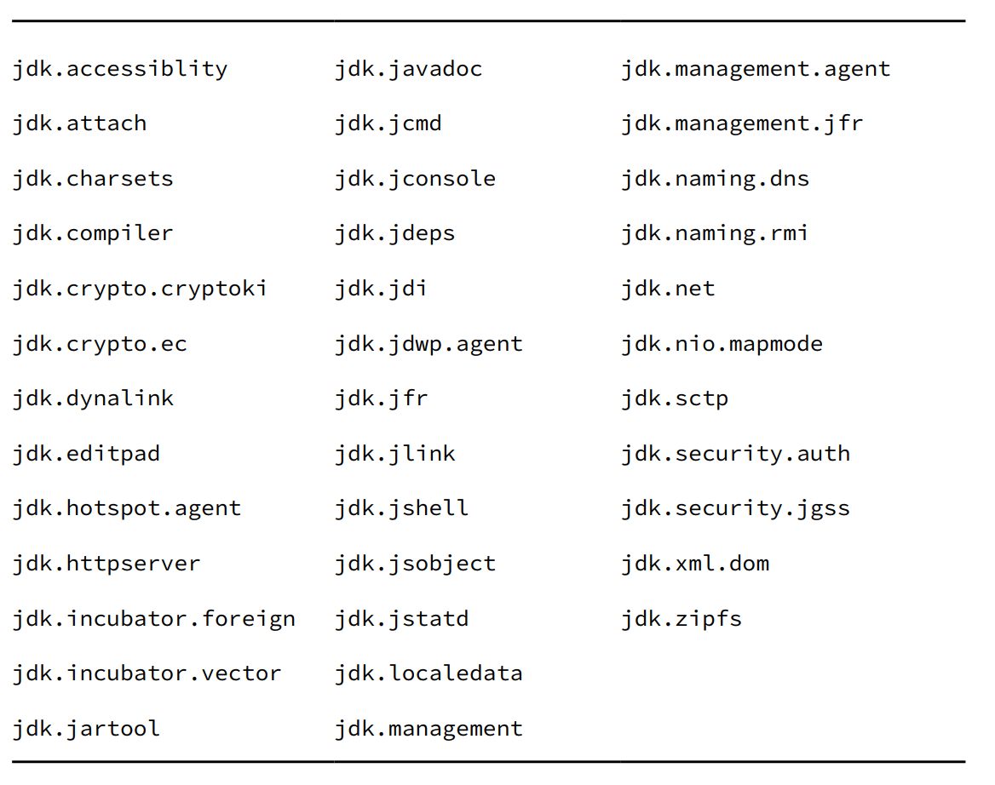
Chapter 12 – Module

Slide 34
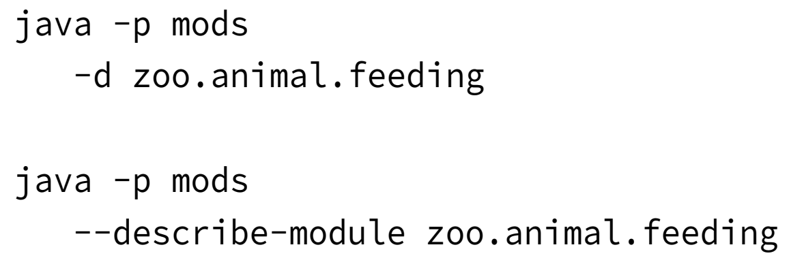
Chapter 12 – Module
Getting Details with Java
- The Java command has 3 flags related to modules
+) ...modules
+) ... modules
+) ...modules
- Note: The java command can also ..., ... and many more. But this is not recommended because it is hard to ... and ...
Describing a Module
- For example we have a module "feeding" and we want to see its .... Of course we can just unzip and ... but it is ... We have another way to do that ...

Slide 35
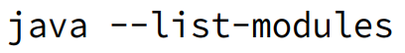
Chapter 12 – Module
(code illustration snippet 32)
- We can see that the first line is ..., then the second line is ..., and the third line is ... We should rememeber that all ... depends on ... module because it is used too much. As we said earlier, ... module are automatically ...
More about Describing Modules
- As we said earlier, we don't need to know the .... but we need to know what it is ... But there is a weird case ...
(code illustration snippet 33)
- We have new things, which is ... exports (this is the full ...)
- The last line is ... because we have ... that is not ... for ...
Listing Available Modules
- We can list all available ... in Java ...

Slide 36

Chapter 12 – Module
- Moreover, we can run ... with our own ...

Slide 37
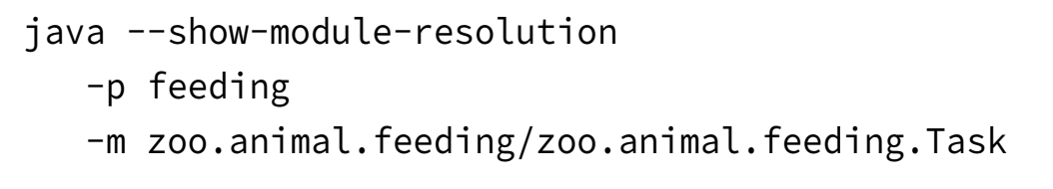
Chapter 12 – Module
- When we run the command, the ... in ... will just ... but with our own ... , it will display an additional ...
(code illustration snippet 34)
- Note: If we use ... flag, Java will .. after ... and won't ... the program ...
Showing Module Resolution
- Using the ... flag will shows the entire ... of the module ...

Slide 38
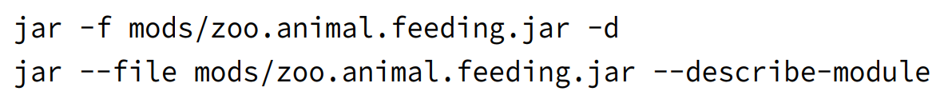
Chapter 12 – Module
(code illustration snippet 35)
Describing with jar
- Just like ... command, the jar command can also ... the module

Slide 39
Chapter 12 – Module
(code illustration snippet 36)
- As you can see ... JAR also have its own ... just like normal ...
Learning about Dependencies with jdeps
- The jdeps command will shows informations about ... in a .... The difference with the describe ... is it takes a look at our .. not just the ... file only ...
- This will shows all including ... use and declared in ... file .... (luckily we don't need to remember all options for this command)
(code illustration snippet 37)
- Notice that we don't need a ... file. This is because we are demonstrating which ... we need to ... this file ... JAR ...
(code illustration snippet 38)
- Now we will run the jdeps command on ... without any ... The first 2 lines is the modules that we need to ... into the ... file ... in order to migrate our app to ... system. Moreover, there will be a table to shows used ... along with its designated ...
(code illustration snippet 39)
- The tables also shows which ... contains ... and used by the ... file
- We also have something called ... mode
(code illustration snippet 40)
- This is a useful feature for the projects that has ... or even ... of packages

Slide 40
Chapter 12 – Module
- The jdeps command also have the ... flags in case you want to search ... outside of ...
(with jdeps, this flag is not ...)
- Note: We can see that the module jdk... doesn't belong to the table.. It is because this is a ... used by the devs in the old version of ... Altough people can ... but it is not recommended to ...
Using the --jdk-internals Flag
- The jdeps command also have a special ... called –jdk-internals, used to provide ... about the ... API ...
(code illustration snippet 41)
- The –jdk-internals Flag will list all ... that uses ... and it will tells us which one is it. At the end, it will also show a table with detail ... to ... API. This is useful with the dev who wrote the code. Some of the solutions such as update, ... the JAR
-jdkinternals ... –jdk-internals
About sun.misc.Unsafe
- Before JPMS, most of the class must be ... in order to use ... outside ... This is reasonable to use ... in JDK because most of of the low level code is ... with JDK. Since this class is used ... outside of the package => Sun set to it as ... modifier. Sun tried to prevent this but ... => which makes it more ... Even some of the OSSs also ... => jdeps was born to solve ... when the ... classs stopped ...

Slide 41
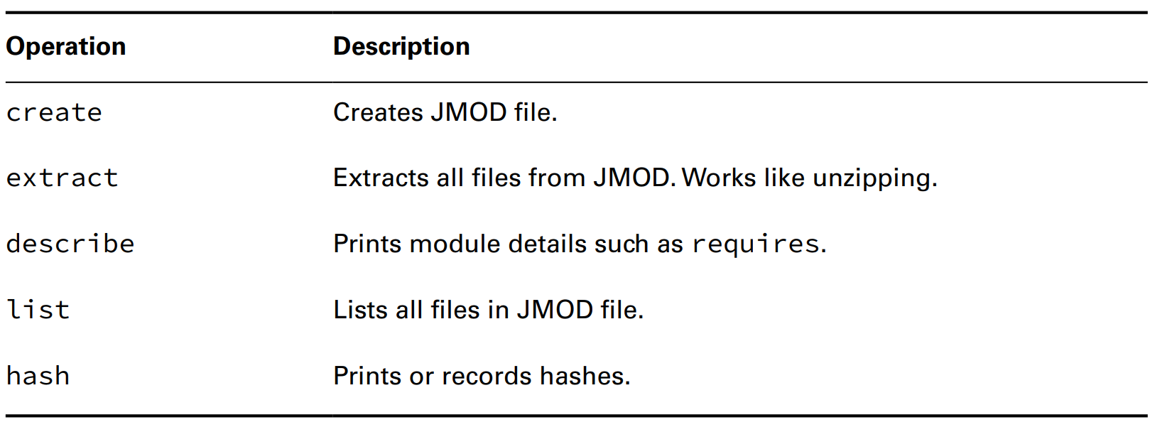
Chapter 12 – Module
Using Module Files with jmod
- This is a command that ... for the exam. We can see jmod file as ... file (although it is a bit more complicated). It is used only wen we have ... that can be jarred
- The jmod command is only usable for ...
– We don't need to know ... but we need to know its existence

Slide 42
Chapter 12 – Module
Creating Java Runtimes with jlink
- As I said earlier, one of the advantage of using ... is ...
– Our zoo example doesn't have much .... If user has bad ... or have limited ... => Forcing them to download ... is ...
– Jlink will remove the ...
– For jlink, the syntax is ...
+) ...specify the module through ...
+) ...specify the packed ... through ...
+) then ... output through
(code illustration snippet 42)
- The output directory contains bin,conf,include, legal, lib, man (which are ...)
- When we zip the ..., the size is ... (roughly ... compared to ...) This is because there are much .. that we don't ...
– There are many ways to custom, but we won't study it in the exam

Slide 43
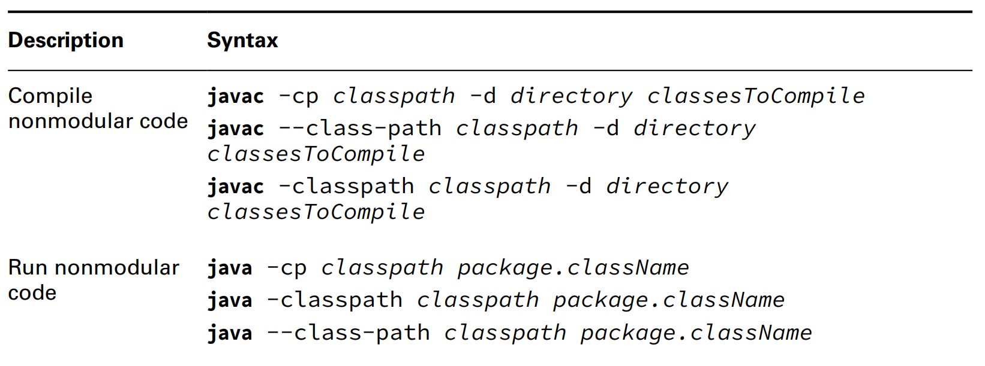
Chapter 12 – Module
Reviewing Command-line options

Slide 44
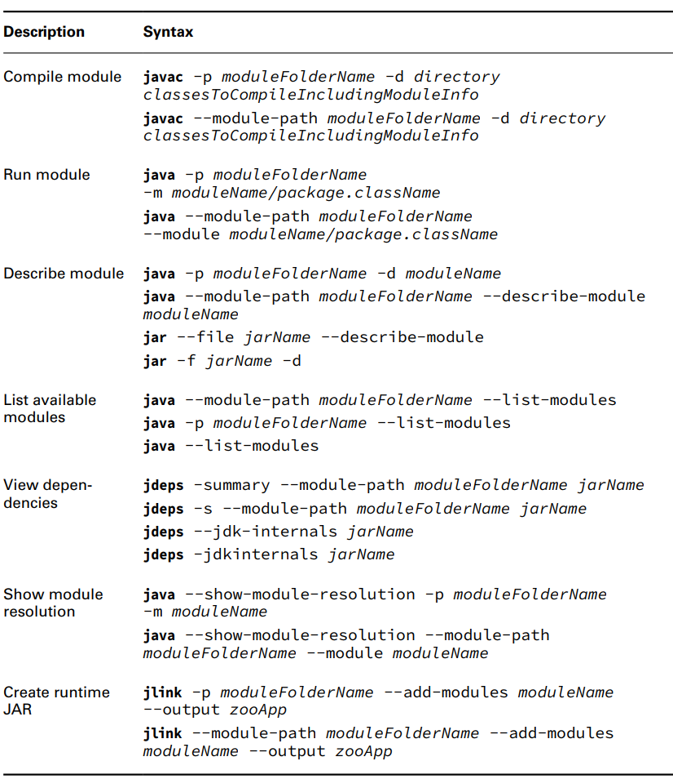
Chapter 12 – Module
Reviewing Command-line options

Slide 45
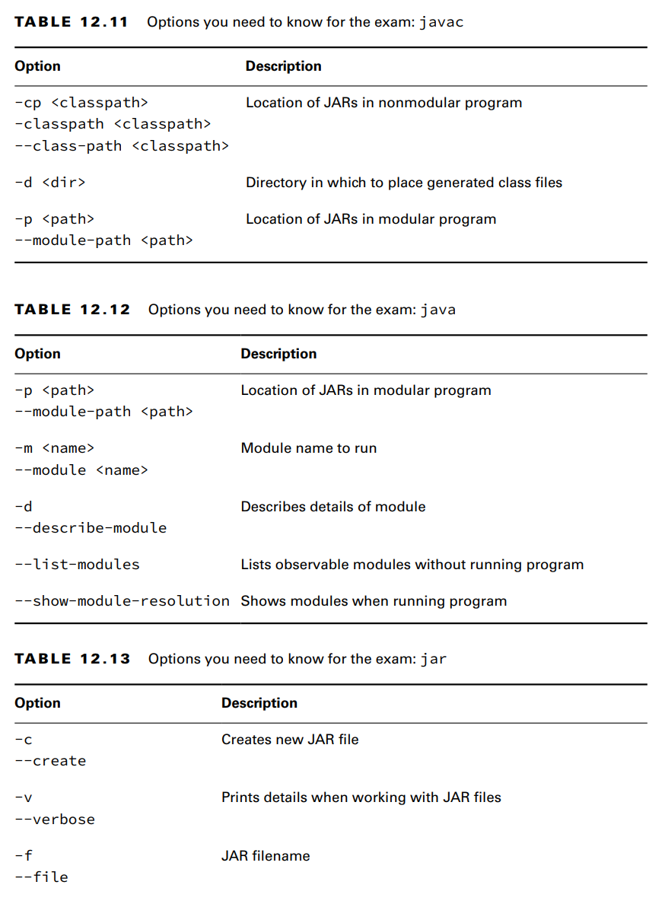
Chapter 12 – Module
Reviewing Command-line options

Slide 46
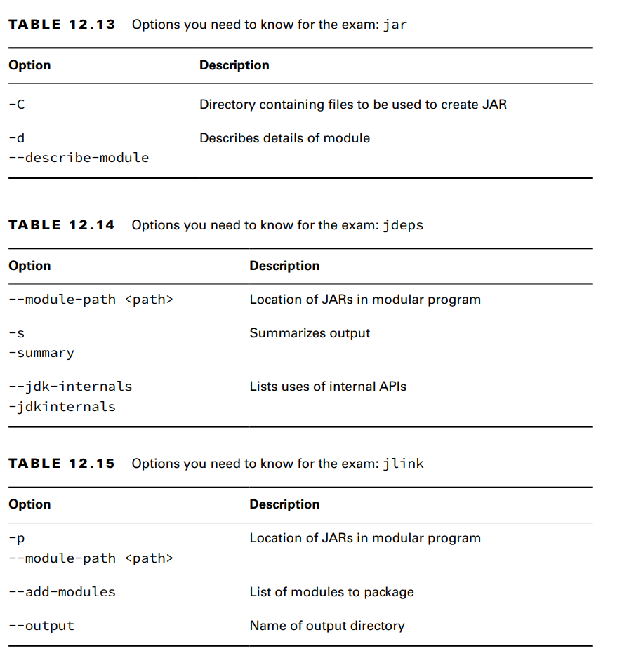
Chapter 12 – Module
Reviewing Command-line options

Slide 47
Chapter 12 – Module
Comparing types of Modules
Named modules
- Named modules is the module that contains .... file. Named module reside in ... path, not ... path. Later on, we will study what happen if a JAR file contain ... file and resides in ... path. For now, just consider it not a ... because it doesn't resides in ... path.
- An easy way to remember ... is named module always ... have ... file
– Revisiting chapter 7: The only way of ... class can be on different package is to reside in a ...
Automatic modules
- Automatic module appears on ... path but it doesn't have ... file. It just simply a ... file reside on ... path. Code that use ... module will be automatcally considered as working with normal ... with .... file.
- A way to remembver this easy is that Java will automatically ... name for this file... This ... module will ... all packages
– To understand the JAR name, we must understand the history of the JAR file. Each JAR ... will contains a .... called ...
– Inside that folder contains a file called ... It could be created ... or .... Back to module, many Java ... aren't ready to migrate ...
– The JAR ... recommended to choose the name ... that devs used for ... by adding a property in ... called ... into the MANIFEST.MF file

Slide 48
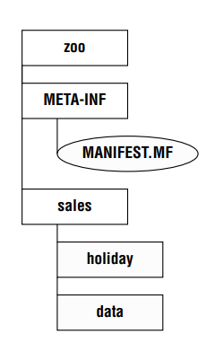
Chapter 12 – Module
About the MANIFEST.MF file
- The JAR file contains a file called ...
– This file contains the information about ... It has existed for a long time, before the ...
– It contains JAR ... such as version of ... For command ... program, the ... file also contain the ... method for ...
- Each line in this file is ... pair, separated by ...

Slide 49
Chapter 12 – Module
- Specifying a single ... in the ... file allows dev to apply their own ... into .... application. We can understand this property is, as soon as this ... become ..., it will have desired ...
– If the JAR file doesnt ..., then Java will use the JAR ... in the ... path. In this case, Java will determine a ...
– Java determines the ... by using the JAR ... itself ...

Slide 50
Chapter 12 – Module
- First of all, Java will remove the ... from the end .... This creates a problem, which is the ... character .... Since ... is not allowed in ..., Java will ... into ... character. Any characters that isn't ... or ... will be considered as ...
– Finally, all trailing ... will be ...
– In general, the rules is
+)
+)
+)
+)
+)
+)

Slide 51
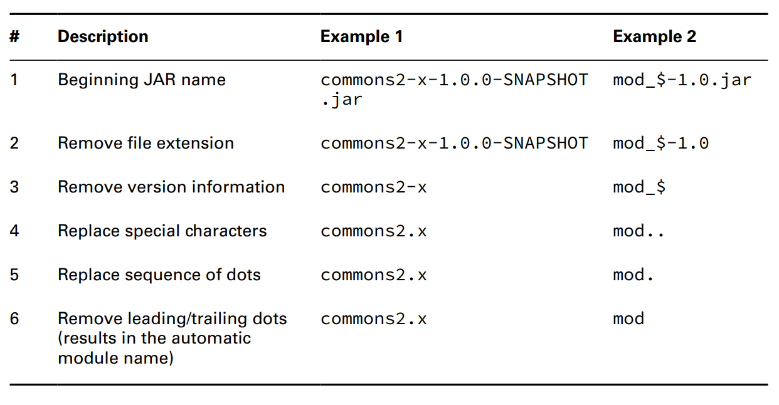
Chapter 12 – Module

Slide 52
Chapter 12 – Module
Unnamed Modules
- Unnamed module will appear in ... path, not ... path. Like automatic module, it is a normal ... file. But differ from automatic module, it resides in ... path not ... path. This means, unnamed module is like ...., below modulized code ...
– An unnamed module usually doesn't have a ... file. If it has ... it will be ... because it is on ... path.
- Unnamed module won't ... to any named/automatic ...
– Unnamed module can read any ... file from ... path/...path ...
– We can understand that unnamed module is Java code before ...
Reviewing Modules types
- A final thing to remember is that code from ... path can read from ... path, but not vice versa ...

Slide 53
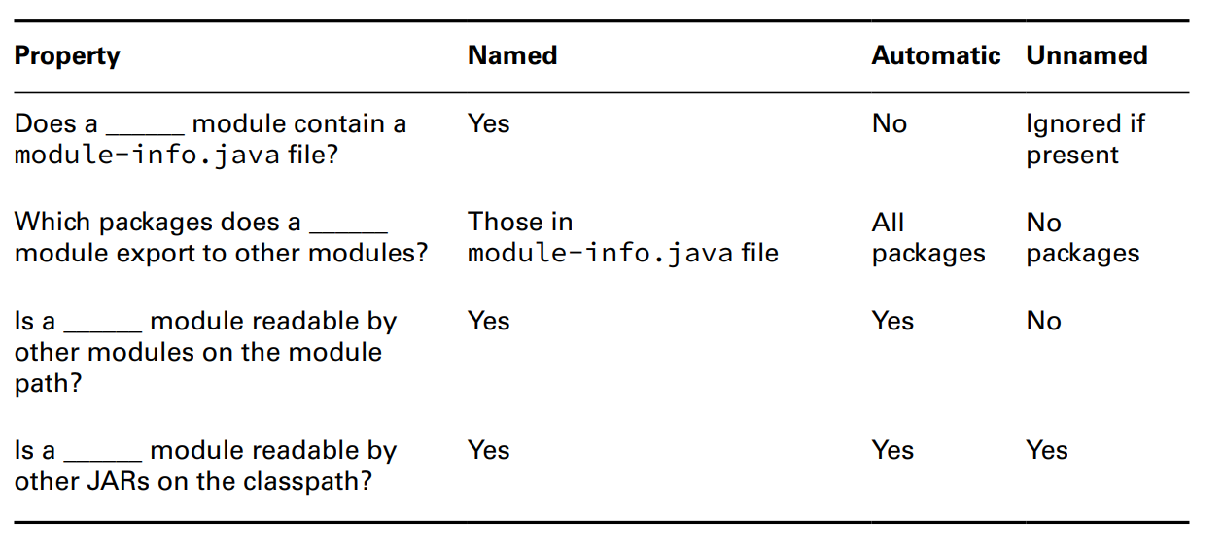
Chapter 12 – Module

Slide 54
Chapter 12 – Module
Migrating an Application
- Many applications arent designed for ... because they was written during ... or it choose not to .... Ideally, they were at least designed ... not just a ... piece of ...
- In this section, we will mention about ... to migrate ... from ... to ...
Migration your application at work
- Exam will assume an environment without ... and because without ... out application will be ... This will make us easier to ... module .... In real life, some of the project even ... that hasn't been ... for ... years ... and its ... graph are ...
– Before ... to ..., we must consider if ..., then ... otherwise ...
– This chapter is used to ... and not for ....
Determining the Order
- Before ... to ..., we must know how ... and ... distribute .... in .... The graph below is a project with ... files ..., and the arrow shows ... between the ... files ... and the arrows goes from ... (requires) and to the .... (exports)

Slide 55
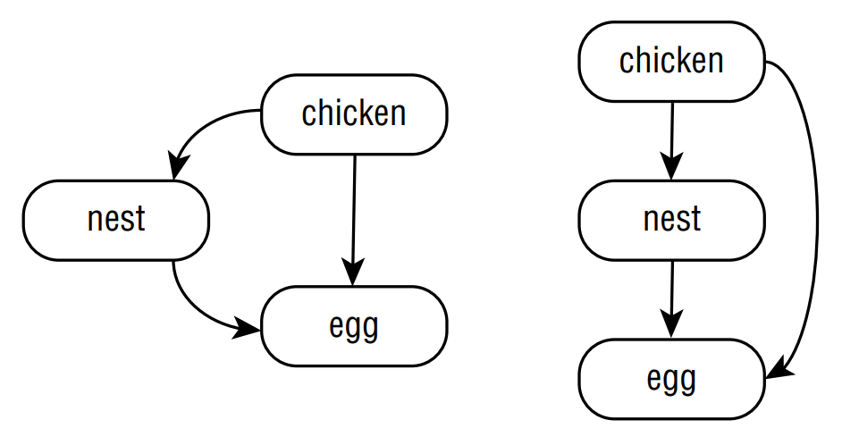
Chapter 12 – Module

Slide 56
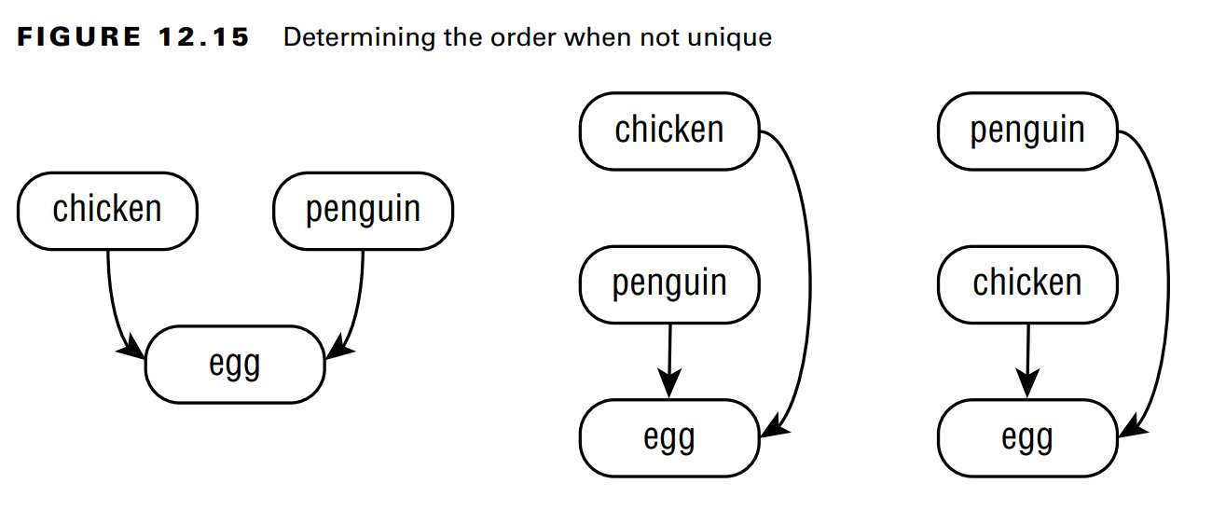
Chapter 12 – Module
- The graph shows which one is ... and which one is ... (the ... strategy also use this ...). Which project has ... then it will be ... and which project has ... then it will be ...
- With the graphs below, we can see that both .... on a single .... and both ... not ... each other ... => The order is ... => not ...

Slide 57
Chapter 12 – Module
Exploring a Bottom-Up migration strategy
- The easiest ... migration ... is Bottom-Up migration. This method ... best when we can ... file into a ...
– Here are the steps:
+) Pick the ... level projects ... not ... to ...
+) Add a ... file into that project ... (make sure to ... directive so that other ...)
+) Move this ... from ... to ... path
+) Make sure that others ... path ...
+) ... the process until ...
– We can see the detail ... with the diagram and the .... happens in order ...
– During migration, we have a bunch of .../... modules with ... modules represent and ... modules represent ... Code on module path cant ...

Slide 58
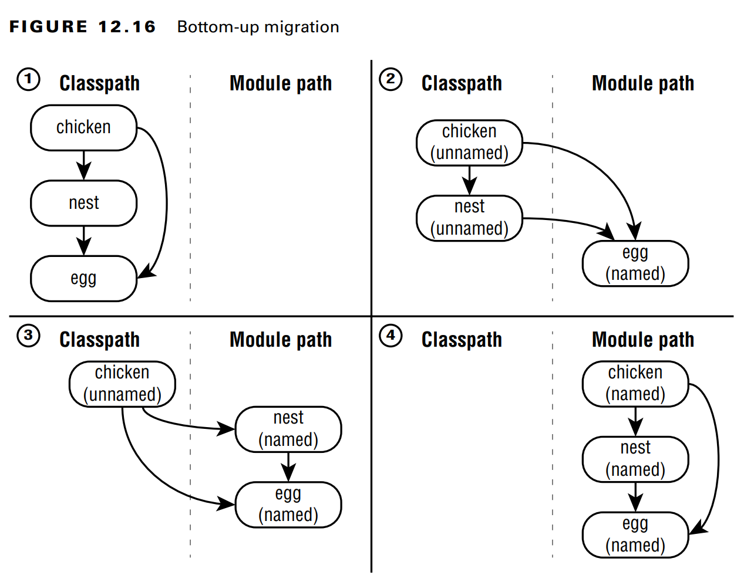
Chapter 12 – Module

Slide 59
Chapter 12 – Module
Exploring a Top-Down migration strategy
- Top-down migration is used when we are ... the ... files (for example, another team ... the ... file and that team is too ... to ... => we don't ...)
- Here are the step:
+) Move all ... path ...
+) Pick the ... level that ... not ...ed ...
+) Add a ... into ... file so that it changes from ... to ... module (make sure to ... directives...) (note: we can use ... name for ...level projects because they haven't been ....)
+) ... the process until ...

Slide 60
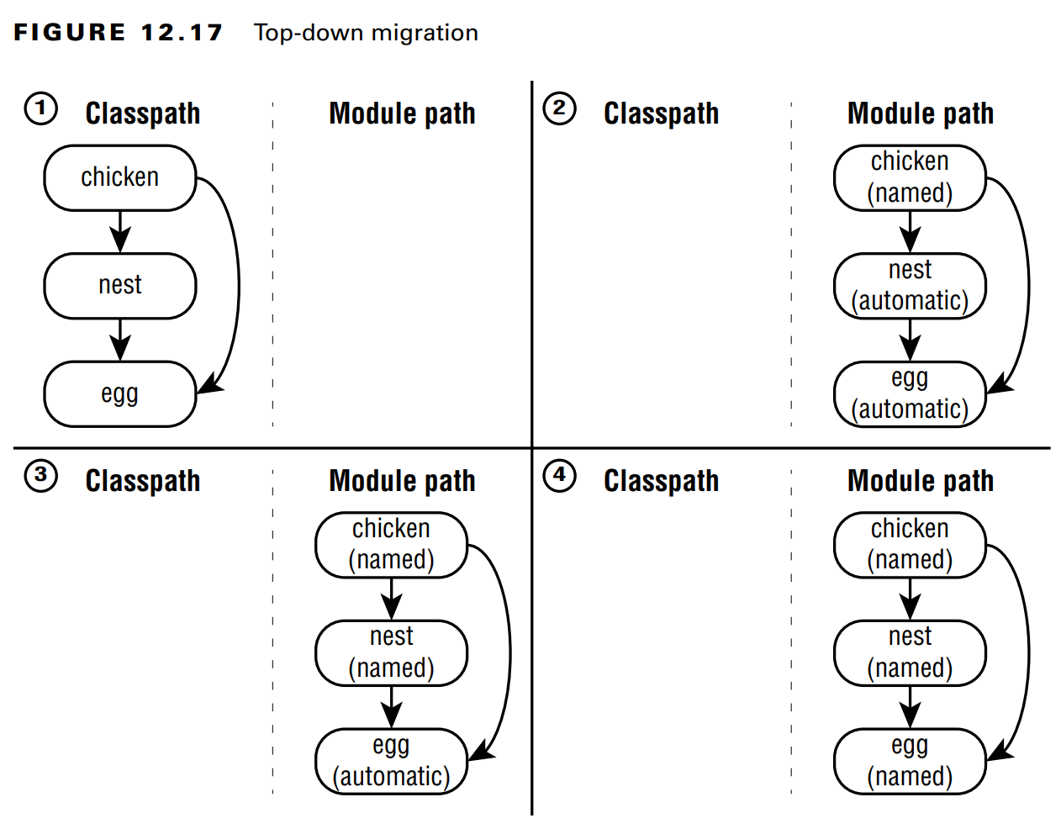
Chapter 12 – Module

Slide 61
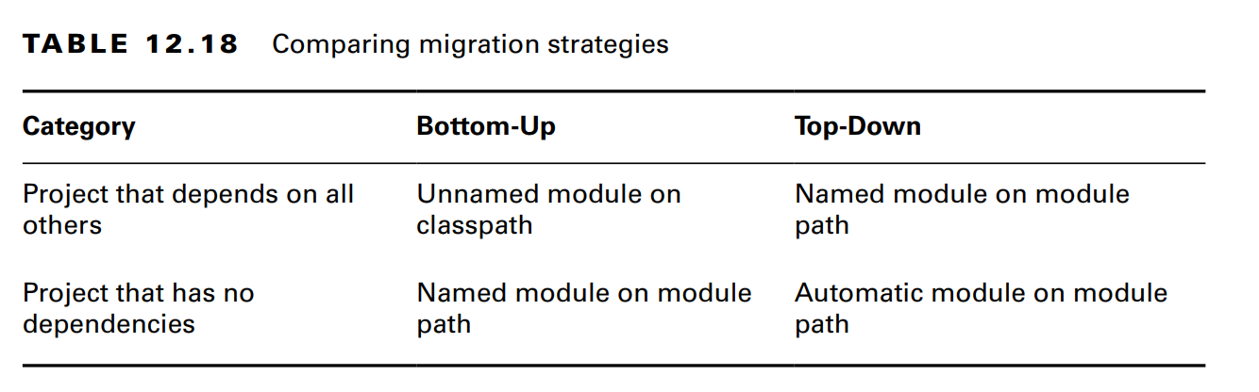
Chapter 12 – Module
- With top-down strategy, we accept the fact that ... level ... aren't ready for ... but we still want our ... to be ...
- During the ... we have a bunch of .../... modules with ... modules represent ... and ... modules represent ...
- ... modules on ... path can access on ... modules which is also on ... path...

Slide 62
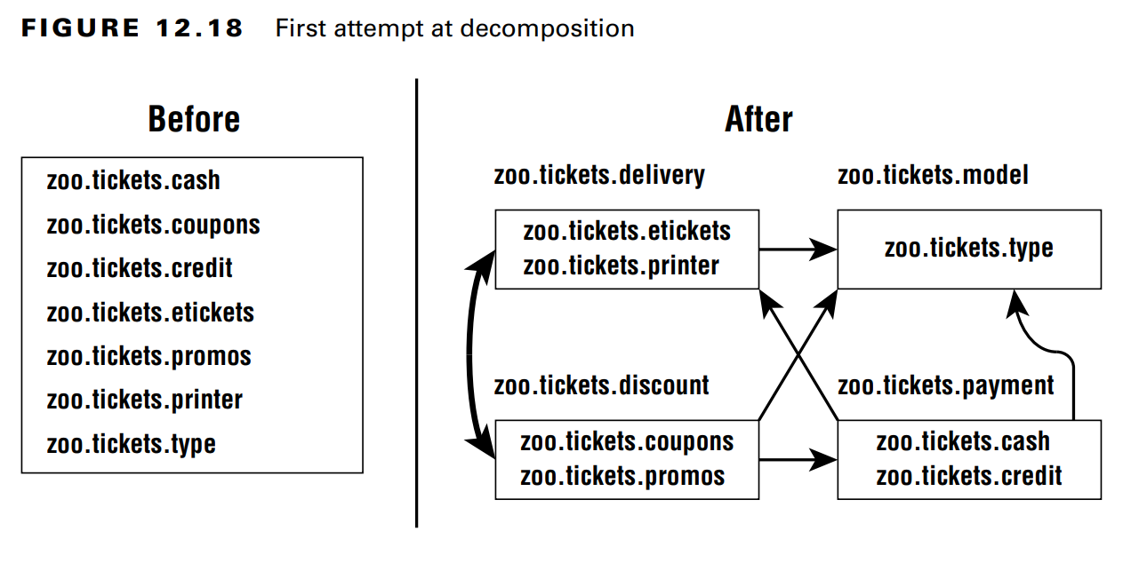
Chapter 12 – Module
Splitting a Big Project into Modules
- For the exam, we must understand the general ... to split a ... into .... Luckily, the ... is generally the same for ... and ... projects
– We start with an assumption with a small ... with just ... few .... The first thing we must ... is split the ... and group them ... and then express ... as ... relationship between ... There will be less ... because some of .... in the same ...

Slide 63
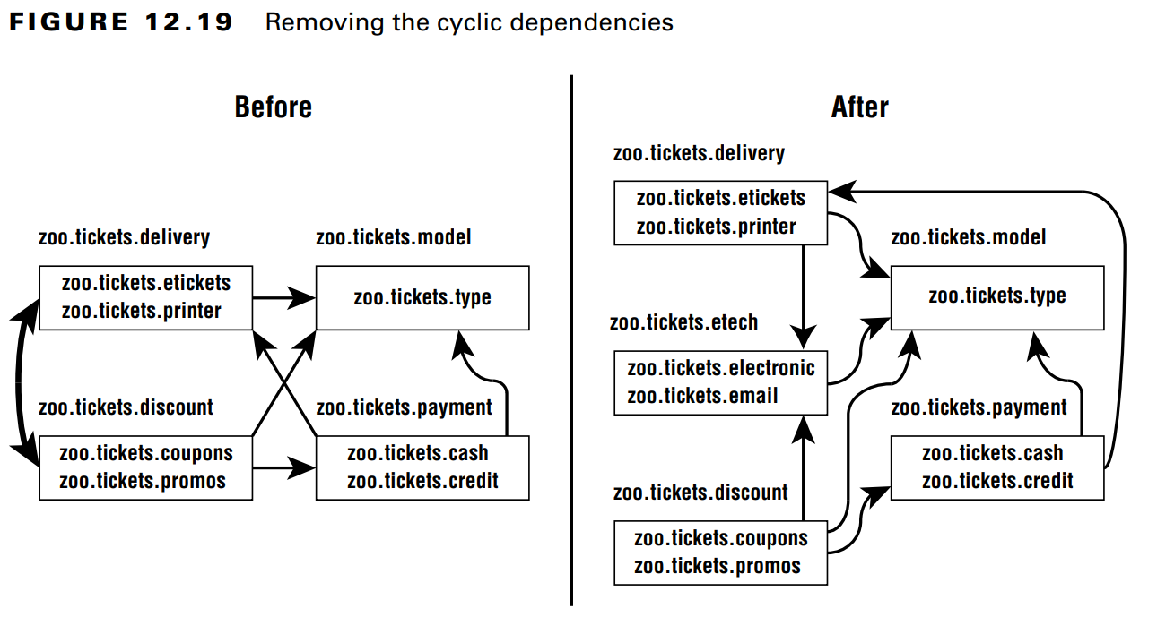
Chapter 12 – Module
- However, this graph has a problem. ... doesnt allow ... (or ...). This means that 2 modules ... (or even ...) on each other ... (... modules ... on ... modules). So how can we handle this ?
- A common way to ... is to create a ... between ...
Failing to Compile with a Cyclic Dependency
- A crucial point we must ... is Java won't ... that has ...

Slide 64
Chapter 12 – Module
(code illustration snippet 43)

